Slide 1
Electromechanical 3D​ Printed Prosthetic Arm Initiative Results
Michael Arnold, Sam Boselli, Paige Durand, Talon Hanssen, Julien Illo, Jonathan Perez​
Notes:
Julien

Slide 2
Project Definition
Notes:
Talon

Slide 3
Prosthetic Affordability
Prosthetic arms are not an affordable option for all amputees
Mechanical arms are a necessity for many in their daily lives or jobs
Notes:
Talon

Slide 4
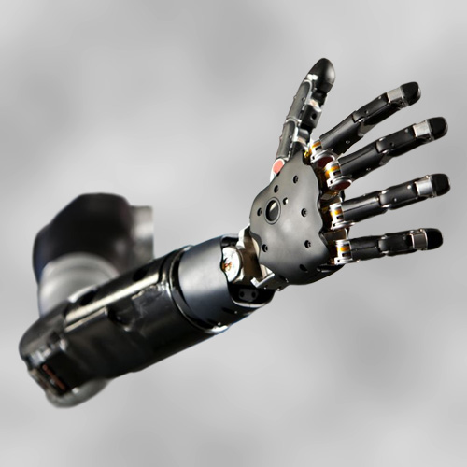
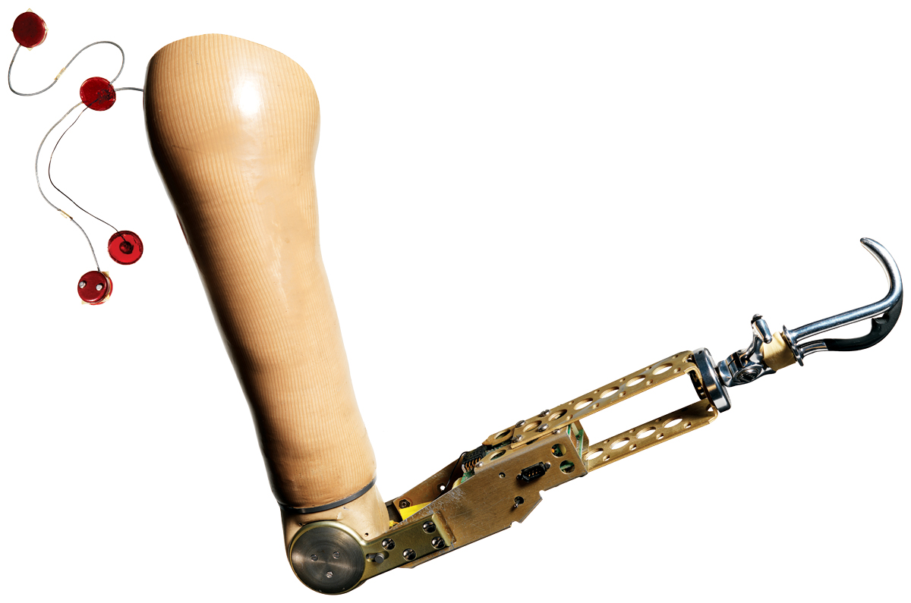
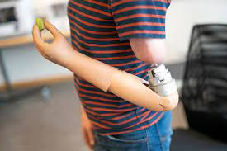
Bionic Limbs
Average cost: $20,000 to $80,000
Notes:
Talon

Slide 5
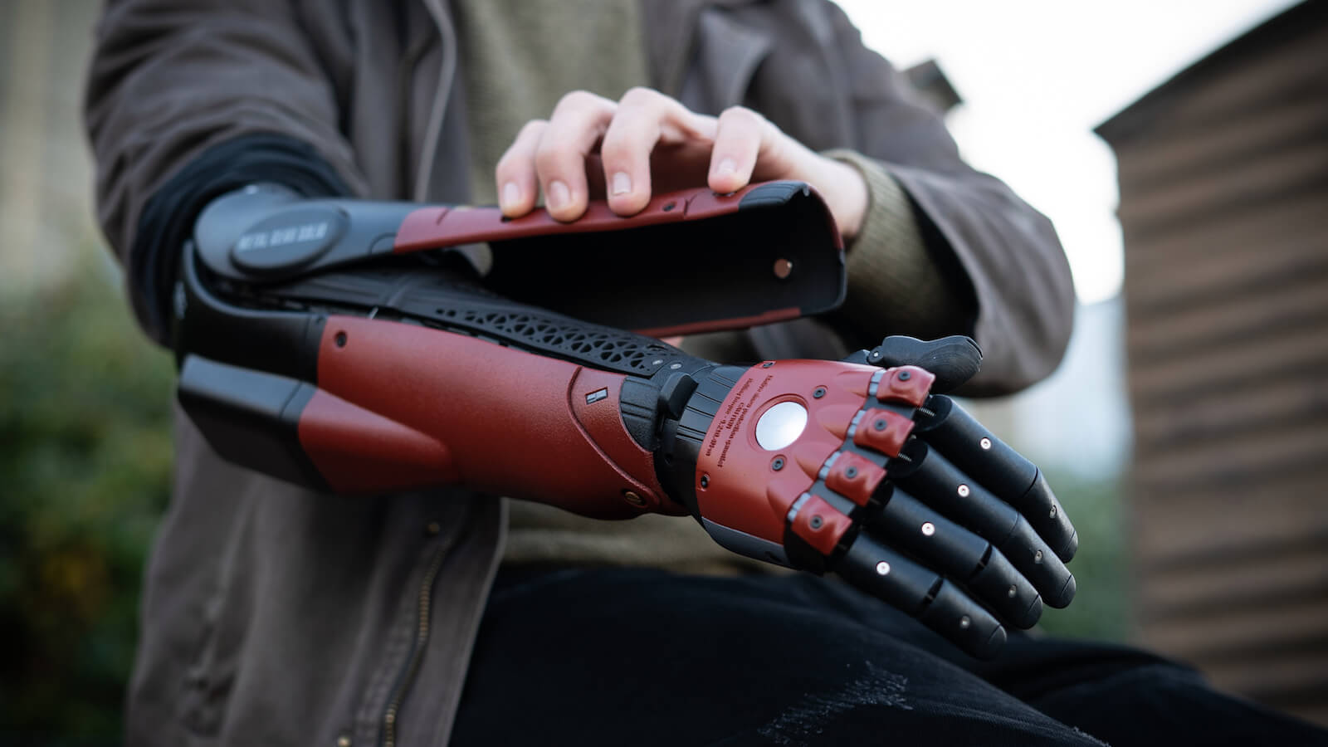
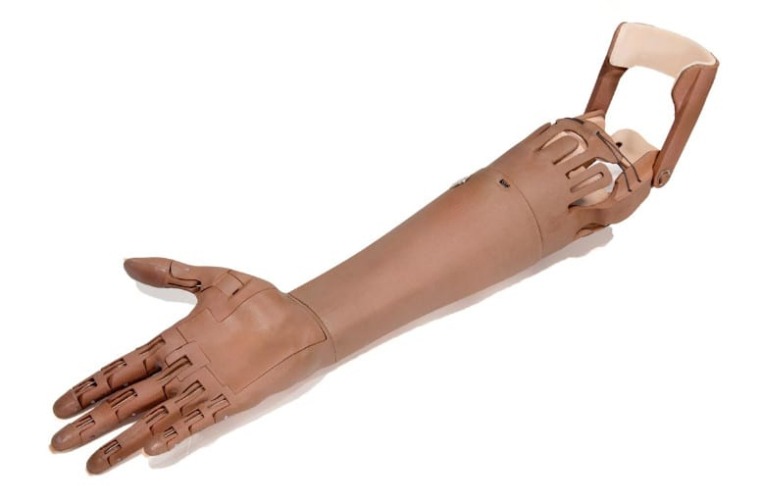
Another Option?
3D printed
Low-cost parts
Universal design
Our Goal: Combine the above elements into an easy DIY assembly
Notes:
Talon

Slide 6
Project Statement
The goal of this project is to design and create a fully 3D-printed prosthetic arm for consumers to use in their daily lives. We aim to accomplish this with a small, six-person team of KSU seniors from Senior Design 2 by May 8th, 2023.
Create a low cost, open-source, 3D printed prosthetic arm.
Notes:
Talon

Slide 7
Deliverables
Fully 3D printed and functional prosthetic arm.
Original SolidWorks models for further adjustment by later teams.
Circuit diagram outlining all connections and components.
Arduino code to fully control the arm.
All documentation created in the creation of the arm.
Notes:
Talon

Slide 8
Provided Constraints
Fully 3D printed (main body)
Force feedback
Lift an egg & and cue ball
4 points of articulation
Elbow, Forearm, Wrist, Fingers
Cost ~$500
Notes:
Talon

Slide 9
Derived Specifications
Completely open-source model (3D printing)
Able to lift at least 3 pounds (strength for cue ball)
Easy to assemble design (ease of use)
Precise movement in all joints (dexterity for egg)
Accurate force feedback in fingers (for egg)
4 points of movement (basic requirement)
Notes:
Talon

Slide 10
Prototype design
Notes:
Jon

Slide 11
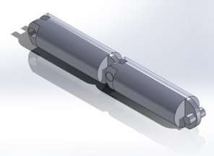
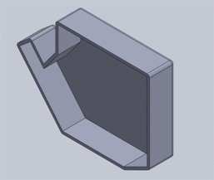
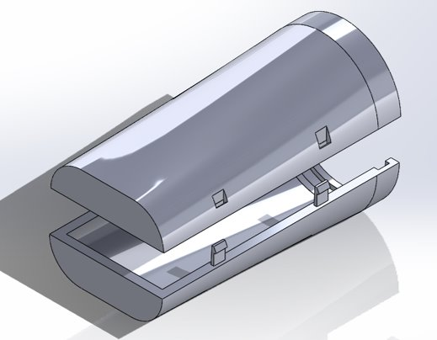
Initial Models
Notes:
Jon

Slide 12
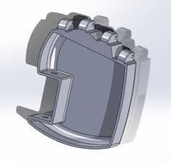
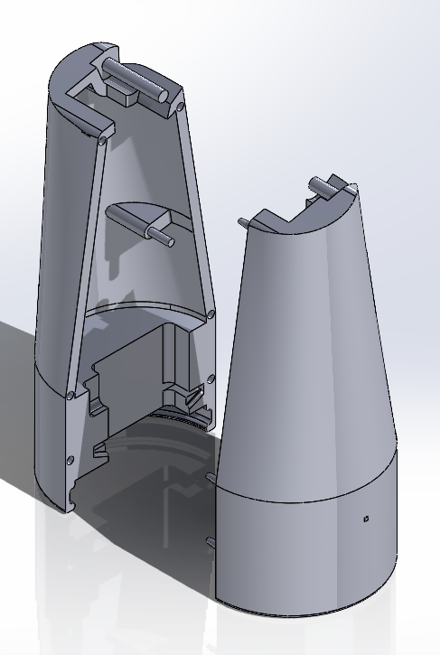
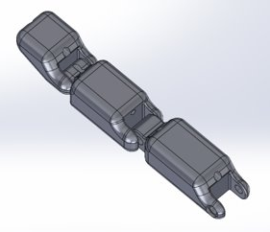
Midway Models
Notes:
Jon –Note implementation of servo mount in forearm, and refinement of further parts

Slide 13
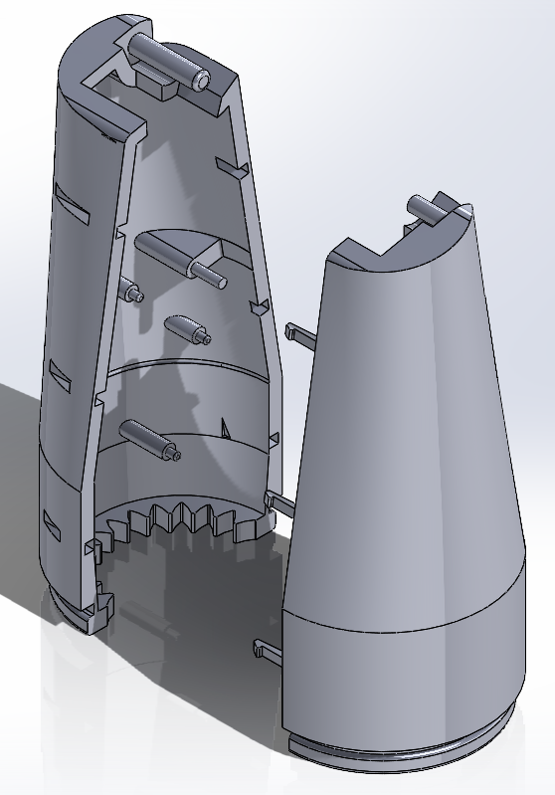
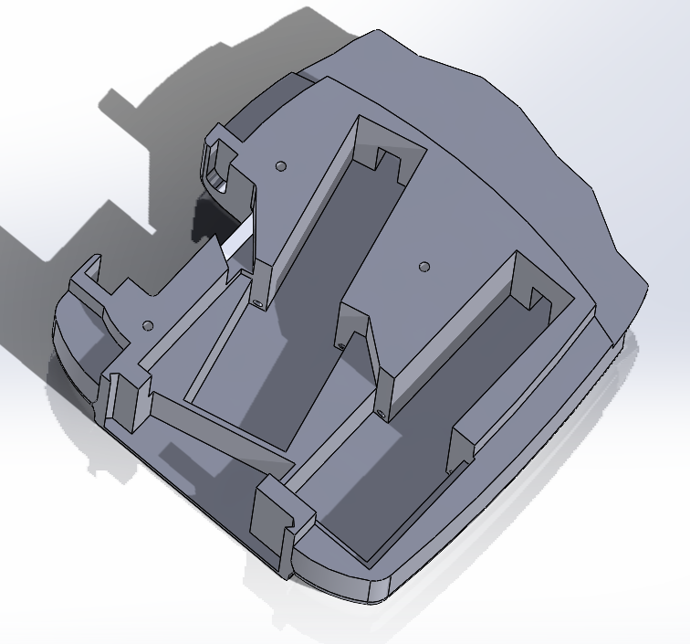
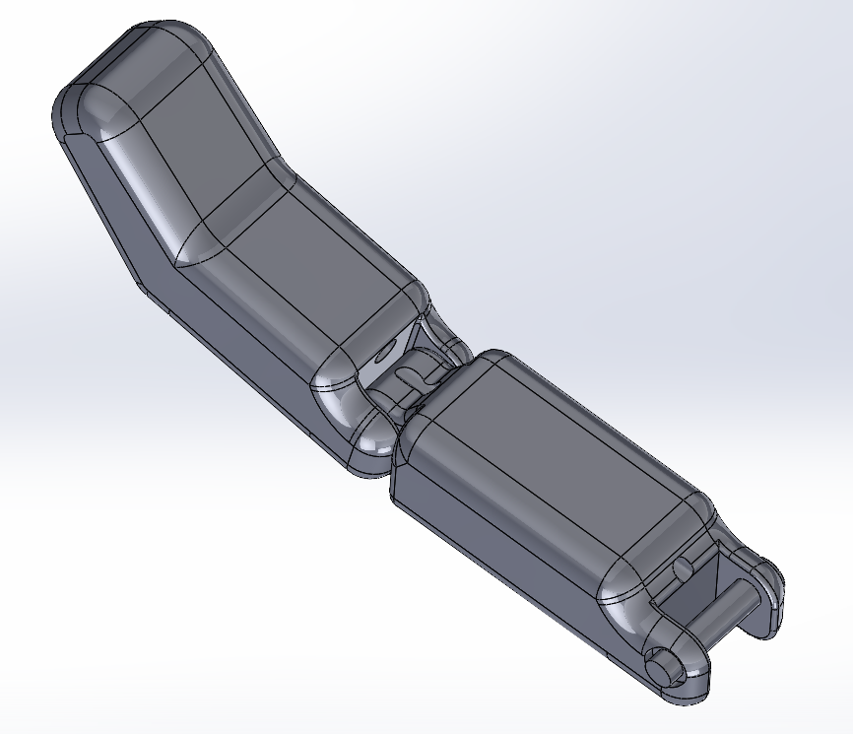
Final Models
Notes:
Jon –Note the finger is reduced to 2 joints, the actuator slots in the hand, the servo mount has been removed from the upper forearm, and the board mounts are implemented into forearm

Slide 14
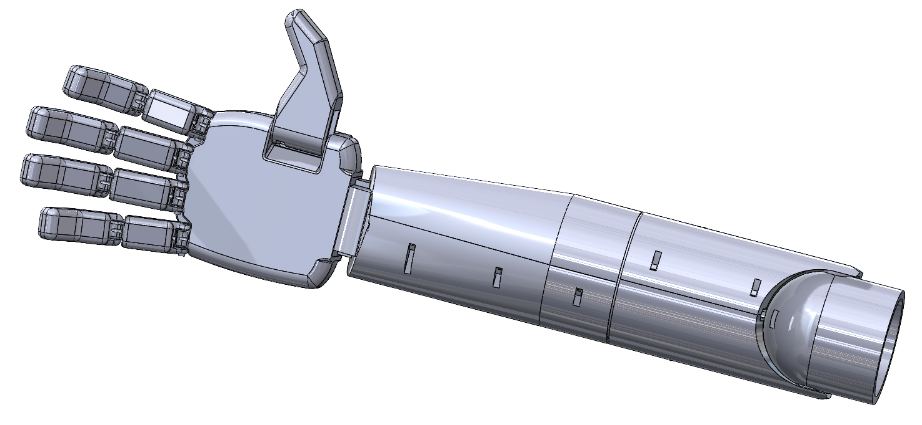
Form of Product
Notes:
Jon

Slide 15
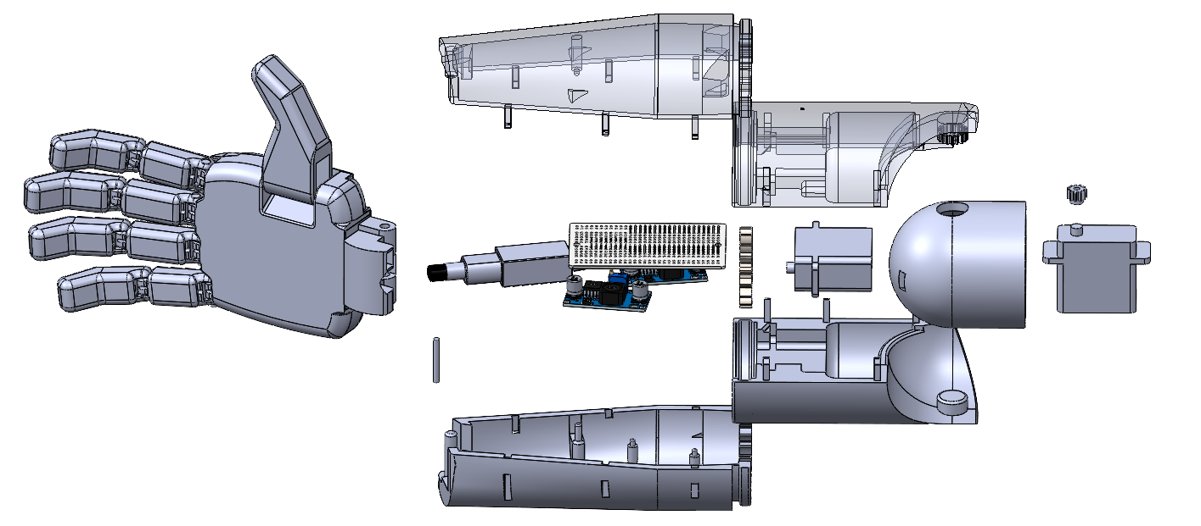
Form of Product
Notes:
Jon

Slide 16
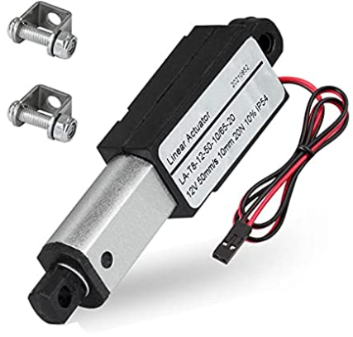
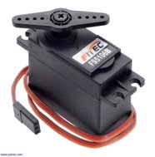
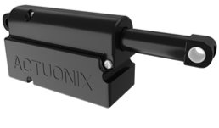


Technical Choices
Finger movement
Actuators vs Servos
Notes:
Julien

Slide 17
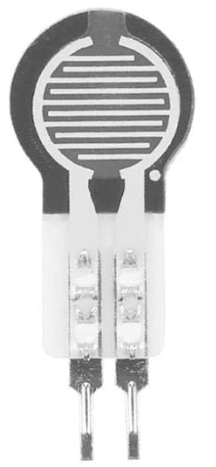
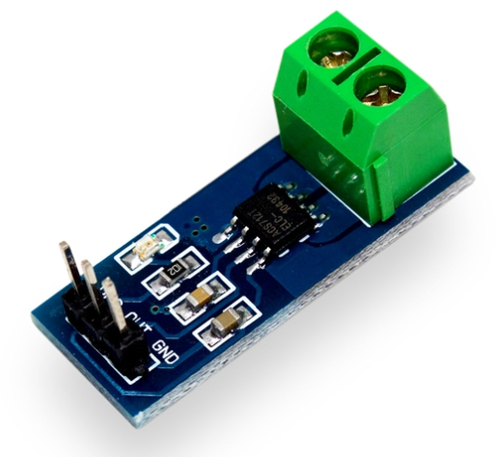
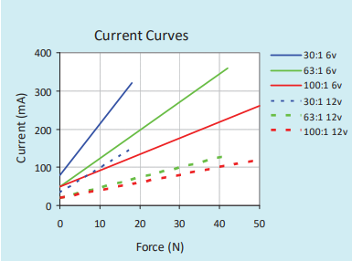
Technical Choices
Pressure Sensing
External Sensor vs Integrated
Max 2kg range
Notes:
Julien

Slide 18
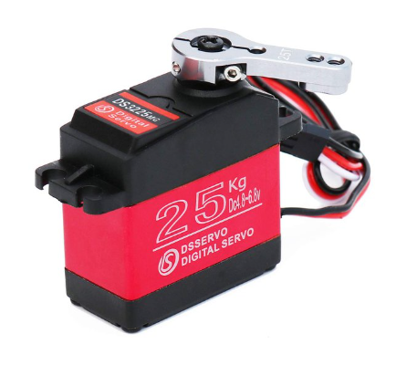
Technical Choices
Arm Movement
Strength and Size
24.5kgcm @ 6.8V
19.2N
Notes:
Julien

Slide 19
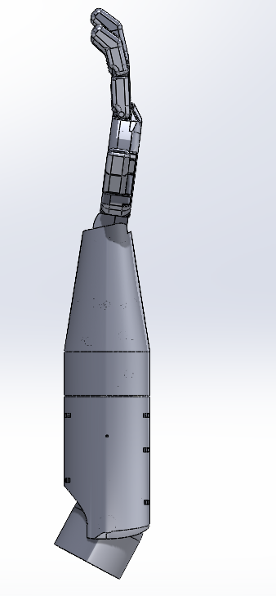
Technical Choices
Elbow Movement
Strength and Material
25kg servo
24.5kgcm @ 6.8V
Arm requires ~12.1kgcm
~1.5 lbs
Centroid
~7 inches
Notes:
Julien

Slide 20
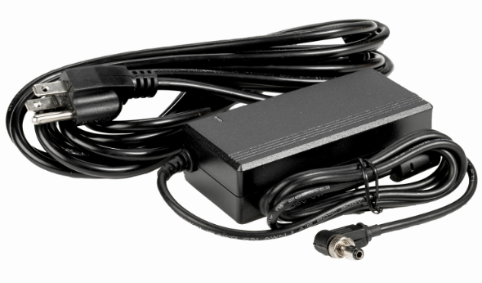
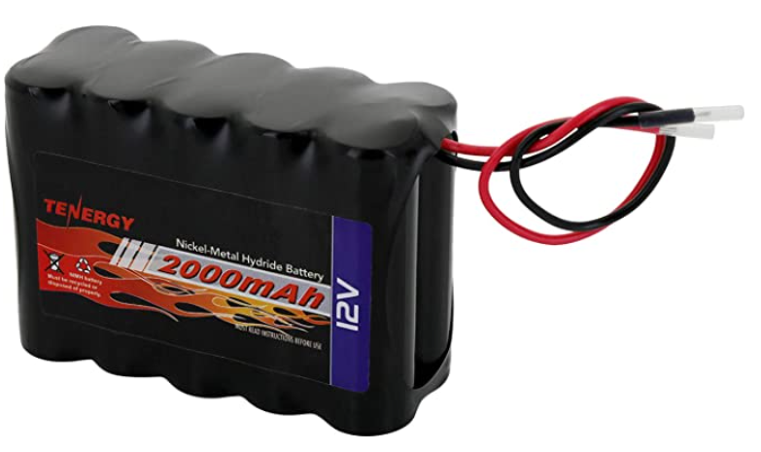
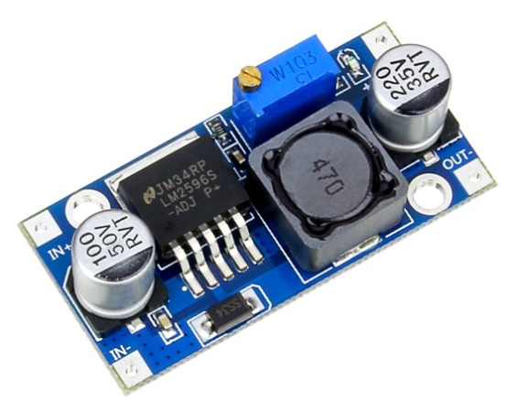
Technical Choices
Power
All components are 12V or 6V
Battery vs Power supply
Buck converters
Electronics not optimized
Notes:
Julien

Slide 21
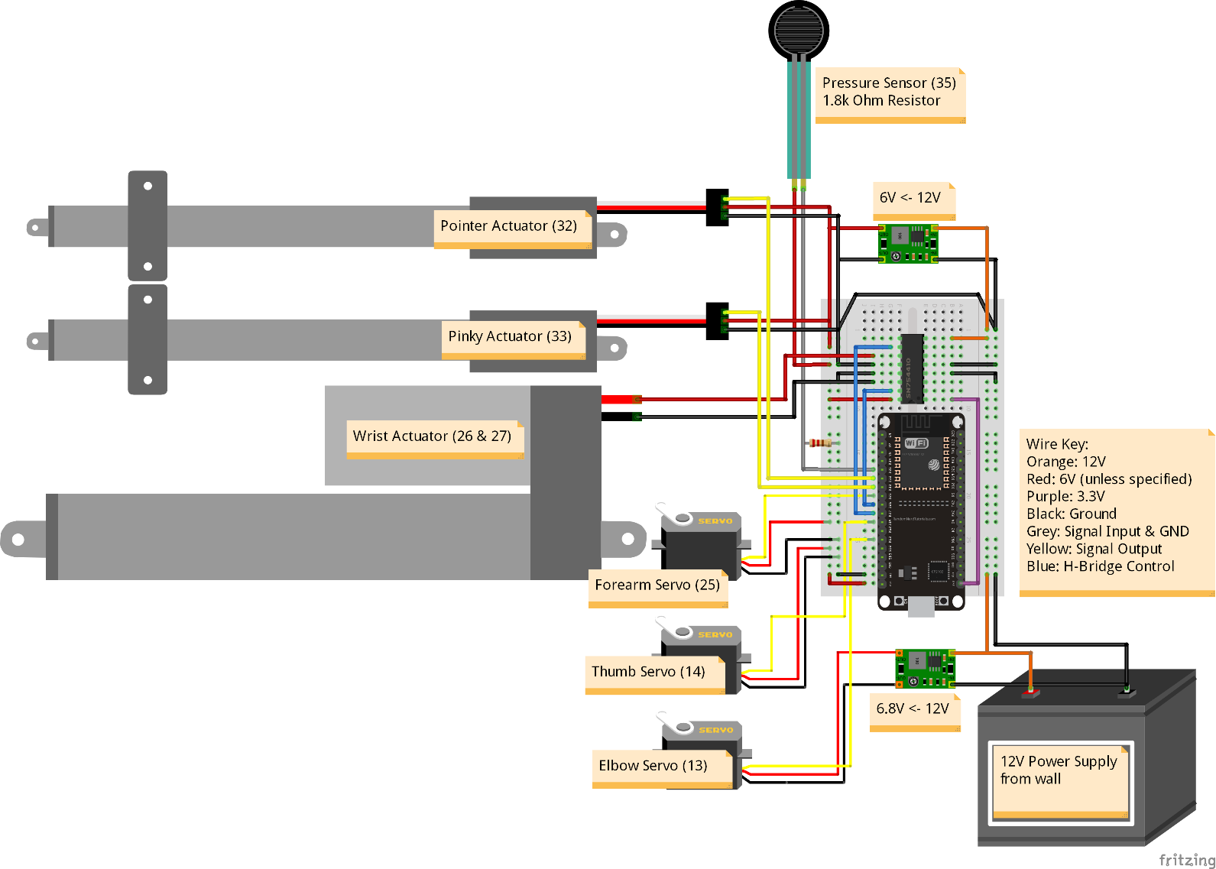
Function of Product (wiring)
Notes:
Julien

Slide 22
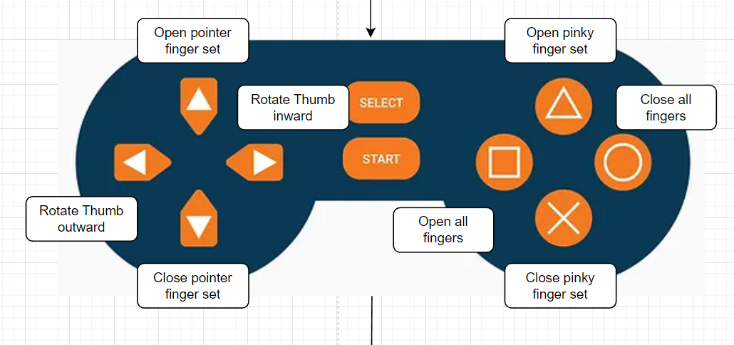
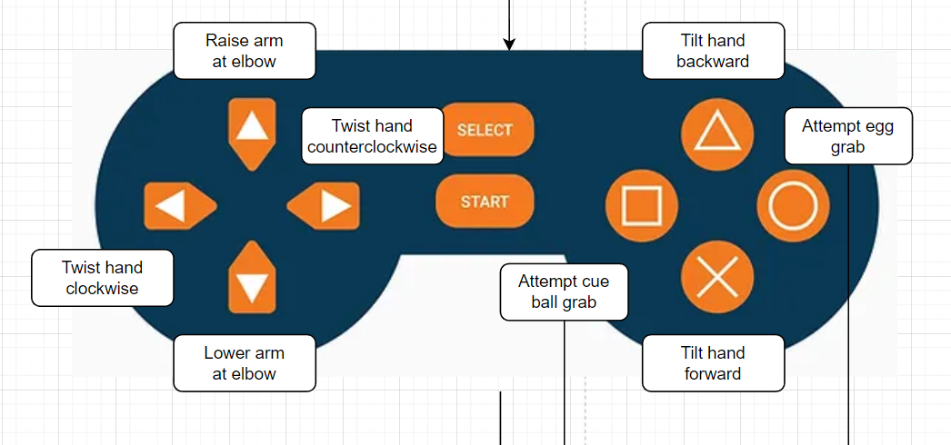
Function of Product (code)
Hand Control
Arm Control
Notes:
Julien

Slide 23
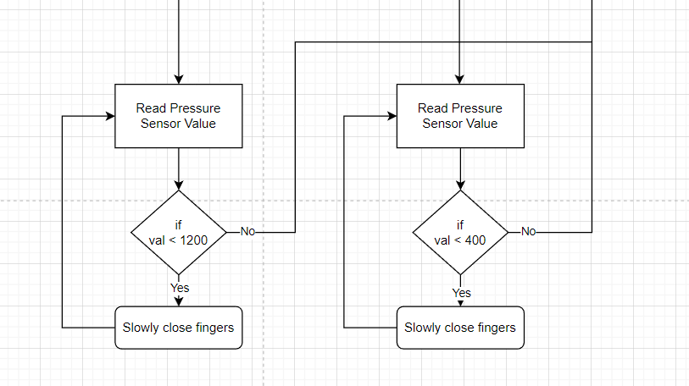
Function of Product (code)
Cue ball Grab
Egg Grab
To button loop
Notes:
Julien

Slide 24
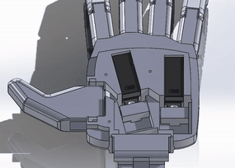
Function of Product (Hand)
Linear actuators contract and push fingers out using a stiff plastic cord
Pressure sensors in between actuator and hand body read force of actuator
Thumb rotates independently via a long servo
Notes:
Sam

Slide 25
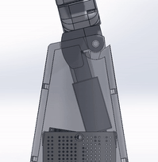
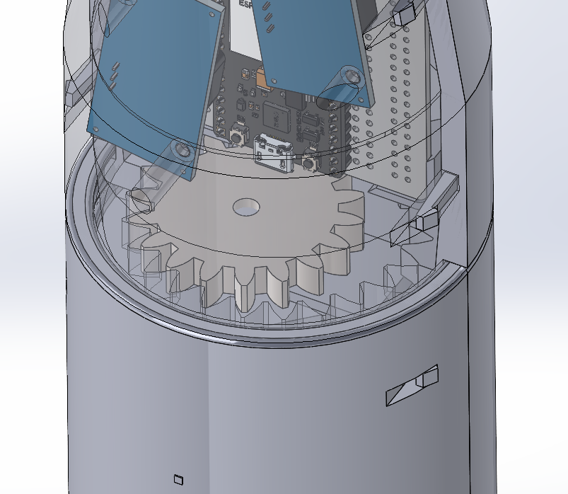
Function of Product (Arm)
Linear actuator extends and contracts to tilt the wrist joint
Servo in lower forearm rotates to turn the upper forearm
Notes:
Julien

Slide 26
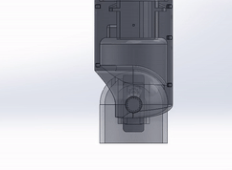
Function of Product (Elbow)
Servo wired through lower forearm
Simple 2-gear design
~2:1 gear ratio
Enclosed housing
Needs stronger gears
Notes:
Talon

Slide 27
Manufacturability & Assembly
Print in Place Fingers
All printed in PLA – readily available and cheap
Snap in place halves
Slide in components
Scalable to hand dimensions
Notes:
Michael

Slide 28
Assumptions
No final control system
Dimensions will be provided for prototype
Electronic PCB sold as a single unit
Future groups would finalize design
Notes:
Michael

Slide 29
Validation of Specifications
4 points of Articulation
Instant pressure feedback
Realistic shape and size
Easy to assemble
Notes:
Michael

Slide 30


Prosthetic Standards
World Health Organization Standards for Prosthetics
Covers general practices for quality/safety/manufacturing
International Organization for Standardization
Specific design specifications and testing practices
WHO ISO
Notes:
Paige

Slide 31
Supporting Material
Notes:
Paige

Slide 32
Ethical/Safety considerations
VOCs produced during 3D printing process can cause dizziness, headaches, and nausea
Cleaning solvents used for 3D printers can be eye, skin, and lung irritants
Minimal risk of electrocution due to electrical components
Notes:
Paige

Slide 33
Bill of Materials
Number | Part | Description | Quantity
1 | Finger Long | Longer version of finger for Ring and middle fingers | 2
2 | Finger Short | Shorter Version of finger for pointer and pinky fingers | 2
3 | Finger Pin | Pin to connect fingers to hand | 4
4 | Thumb | Thumb piece with move for servo | 1
5 | Thumb Block | Holds the thumb in place | 1
6 | Block Wide | Holds the thumb in place | 1
7 | Finger Triangle | Fits into back of fingertips to hold the cables in place | 4
8 | Hand | Hand piece holds hardware for finger movement | 1
Notes:
Paige

Slide 34
Bill of Materials cont'd
Number | Part | Description | Quantity
9 | Hand Top | Lid for the hand hold everything in place | 1
10 | Hand Divider | Put into the hand piece to split apart mechanical movements and wiring | 1
11 | Finger Slide | Attaches the linear actuators to the cables that move the fingers | 2
12 | Wrist Joint | Connects the hand to forearm with passthrough for wires and mount for linear actuator that provides wrist movement. | 1
13 | Upper Forearm Male | Upper forearm outer shell | 1
14 | Upper Forearm Female | Upper forearm outer shell | 1
15 | Lower Forearm Male | Lower forearm outer shell | 1
16 | Upper Forearm Female | Lower forearm outer shell | 1
Notes:
Paige

Slide 35
Bill of Materials cont'd
Number | Part | Description | Quantity
17 | Elbow Base | Structure of elbow that can be mounted to something else | 1
18 | Elbow Gear | Gear to transfer rotation from servo to elbow | 1
19 | Forearm Gear | Gear to transfer rotation from servo to forearm | 1
20 | Actuator Pin | Pin to attach actuator to the wrist joint | 1
21 | Linear Actuator (Hand) | 100:1, PQ12-R, 6V actuator pulls the wire attached to fingers to open and close fingers | 2
22 | Servo Motor (Thumb) | MG90S, 9g Micro servo to rotate thumb | 1
23 | Linear Actuator (Wrist) | 0.8in (21mm) stroke length, moves the wrist up and down | 1
24 | Servo Motor (Elbow) | 25Kg, 270deg digital servo to rotate elbow | 1
Notes:
Paige

Slide 36
Bill of Materials cont'd
Number | Part | Description | Quantity
25 | Servo Motor (Forearm) | 25Kg, 270deg digital servo to rotate forearm | 1
26 | PCB Board Kit | Prototype kit to build a custom PCB board for connections | 1
27 | 1kg Filament Roll | PLA filament to print 3D components | 1
28 | 12V Power Supply | 12V DC, 5 Amp power supply to plug into arm and wall | 1
29 | Hanging Wire | 15ft invisible hanging wire to attach finger joints to the hand linear actuators | 1
30 | Grip Tape | 2in, 23ft anti-slip tape for fingertips | 1
31 | ESP32 | 36 pin, controls the electrical components of the arm | 1
32 | H-Bridge | Helps with converting the DC current | 1
Notes:
Paige

Slide 37
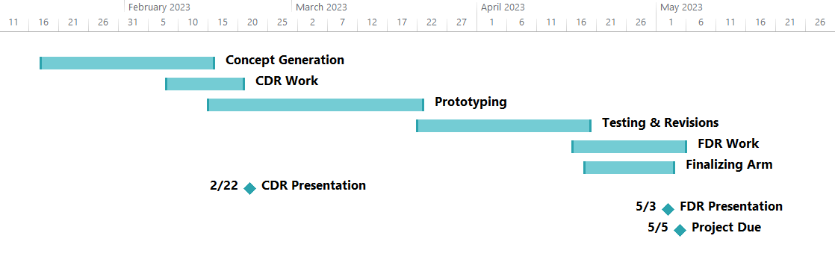
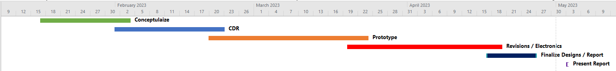
Gantt Chart
Notes:
Michael

Slide 38
Initial Cost Estimate
Item | Cost
PLA Filament | $25.00
Actuonix Linear Actuators X 3 | $195.00
Servos X 2 | $68.00
Arduino Mega Controller | $20.00
Pressure Sensors X 2 | $14.40
General Linear Actuator | $29.00
Misc. Hardware | $20.00
Total | $371.40
Notes:
Michael

Slide 39
Final Costs
Item | Quantity | Unit Cost | Total Cost
Finger Actuators | 2 | $70.00 | $140.00
Thumb Servo | 1 | $10.99 | $10.99
Wrist Actuator | 1 | $28.99 | $28.99
Elbow Servo | 1 | $16.50 | $16.50
Forearm Servo | 1 | $16.50 | $16.50
PCB Board Kit | 1 | $15.99 | $15.99
1kg PLA Filament | 1 | $19.99 | $19.99
12V Power Supply | 1 | $11.99 | $11.99
Hanging Wire | 1 | $2.89 | $2.89
Grip Tape Roll | 1 | $7.85 | $7.85
ESP32 (36 pin) | 1 | $10.99 | $10.99
H-Bridge (SN754410NE) | 1 | $2.91 | $2.91
Total |  |  | $285.59
Notes:
Michael –mention that Elbow & Forearm servos were a 2 pack, and PCB board kit includes wires and solder

Slide 40
Proof of specifications
Demonstration of movement, articulation, and pressure sensing
Notes:
Live demonstrations

Slide 41
Notes For Next Design
Test different cable options
Rework snap fit design for ease of assembly
Electrical management & optimization
Non-electromechanical elbow design
Notes:
Talon

Slide 42
Questions?

